Slide 1

Need New Table(s) ?
The problem is we don’t have a table to track our orders!

Slide 2
Need New Table(s) ?
The problem is we don’t have a table to track our orders!
1

Slide 3
Need New Table(s) ?
1
The problem is we don’t have a table to track our orders!

Slide 4
Need New Table(s) ?
1
The problem is we don’t have a table to track our orders!
However order details needs to tracked also
2

Slide 5
Need New Table(s) ?
1
The problem is we don’t have a table to track our orders!
2
However order details needs to tracked also
Where was order delivered?

Slide 6
Need New Table(s) ?
1
The problem is we don’t have a table to track our orders!
2
However order details needs to tracked also
Where was order delivered?
3

Slide 7
Need New Table(s) ?
1
The problem is we don’t have a table to track our orders!
2
However order details needs to tracked also
3
Where was order delivered?

Slide 8
Need New Table(s) ?
1
The problem is we don’t have a table to track our orders!
2
However order details needs to tracked also
3
Where was order delivered?
4
We are going bigger!!!

Slide 9
Need New Table(s) ?
1
The problem is we don’t have a table to track our orders!
2
However order details needs to tracked also
3
Where was order delivered?
4
We are going bigger!!!

Slide 10
Need New Table(s) ?
1
The problem is we don’t have a table to track our orders!
2
However order details needs to tracked also
3
Where was order delivered?
4
We are going bigger!!!

Slide 11
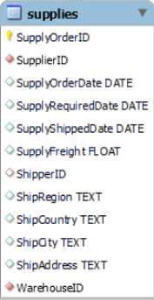
Need New Table(s) ?
1

Slide 12
Need New Table(s) ?
1
The problem is we don’t have a table to track our orders!
2
However order details needs to tracked also
3
Where was order delivered?
4
We are going bigger!!!

Slide 13
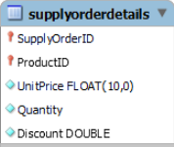
Need New Table(s) ?
2

Slide 14
Need New Table(s) ?
1
The problem is we don’t have a table to track our orders!
2
However order details needs to tracked also
3
Where was order delivered?
4
We are going bigger!!!

Slide 15
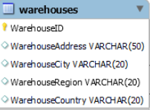
Need New Table(s) ?
3

Slide 16
Relationship Among New Tables
2
1
3

Slide 17
Need New Table(s) ?
1
The problem is we don’t have a table to track our orders!
2
However order details needs to tracked also
3
Where was order delivered?
4
We are going bigger!!!

Slide 18

We are Going Bigger!!!
4
Our company is going bigger and collects more data. So we need to store data properly in a powerful tool than SQLite.
We migrated to MySQL.
Data is safe ☺

Slide 19
We are Going Bigger!!!
4
Our company is going bigger and collects more data. So we need to store data properly in a powerful tool than SQLite.
We migrated to MySQL.
Data is safe ☺

Slide 20
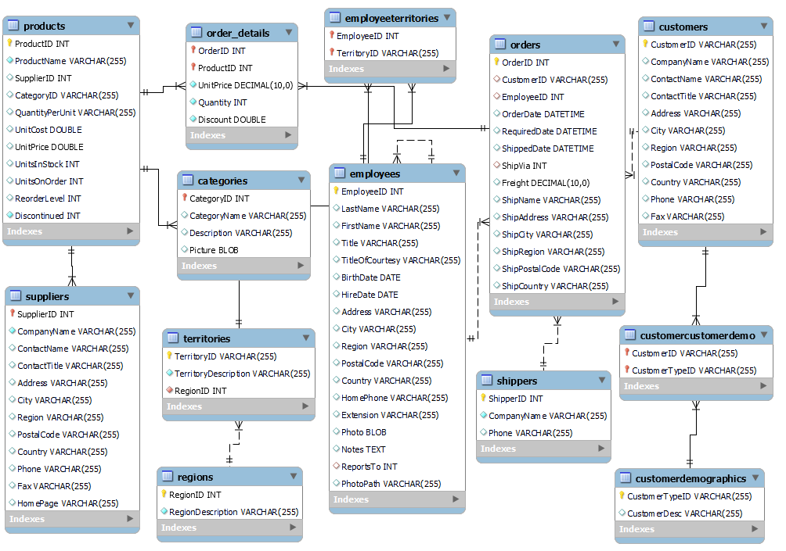

Slide 21
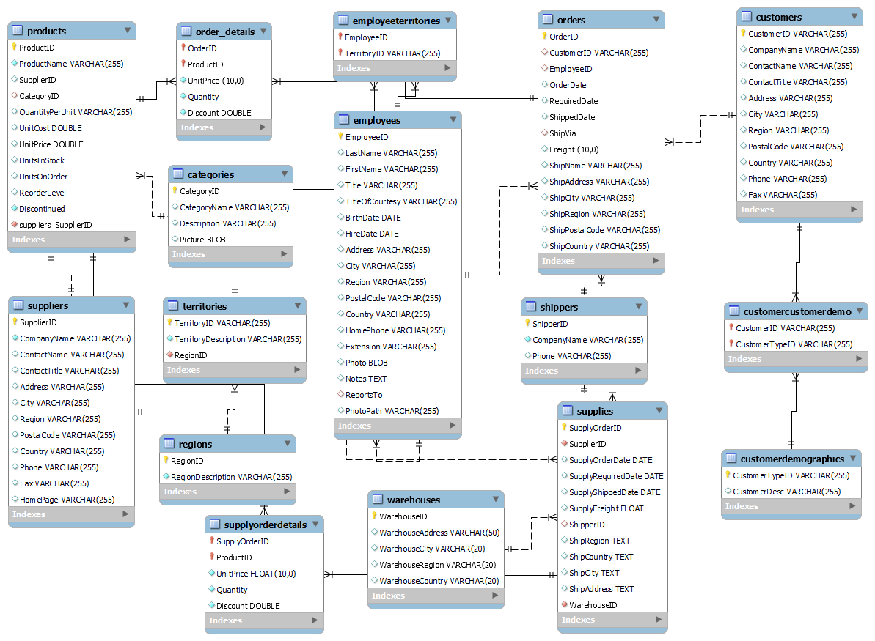

Slide 22

MySQL Is Powerful In Solving Business Problems
1
MySQL automizes solving business problems with its high variety of features.

Slide 23
MySQL Is Powerful In Solving Business Problems
1
MySQL automizes solving business problems with its high variety of features.
2
MySQL provides high performance to its user.

Slide 24
MySQL Is Powerful In Solving Business Problems
1
MySQL automizes solving business problems with its high variety of features.
2
MySQL provides high performance to its user.
3
It gives developers higher productivity by using views, stored procedures etc.

Slide 25

The Company Is Seeking New Destinations!
Objective:

Slide 26
The Company Is Seeking New Destinations!
Objective:
Find the city (currently operated) where closest to the city we want to start operating.

Slide 27
The Company Is Seeking New Destinations!
Objective:
Find the city (currently operating) where closest to the city we want to start operating.
1
How can we determine distance between cities or provinces?

Slide 28
The Company Is Seeking New Destinations!
Objective:
Find the city (currently operating) where closest to the city we want to start operating.
1
How can we determine distance between cities or provinces?
2
How can we compare these distances in SQL?

Slide 29
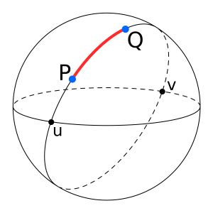
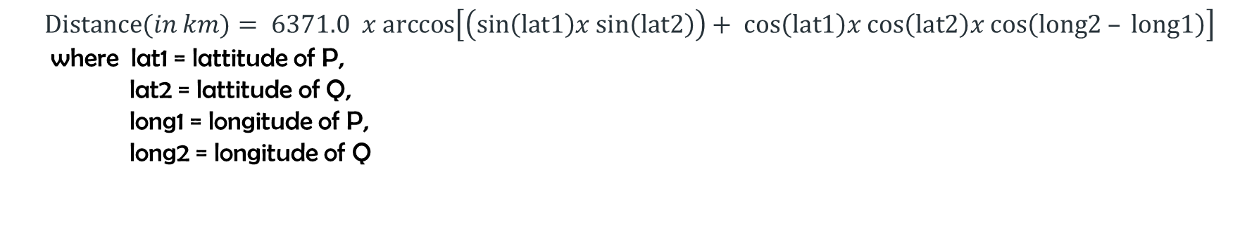
Let’s Do Some Maths!
$$Distance(in km)= 6371.0 x arccos\left[\left(sin\left(lat1\right)x sin\left(lat2\right)\right)+ cos\left(lat1\right)x cos\left(lat2\right)x cos\left(long2 – long1\right)\right]$$
where lat1 = lattitude of P,
lat2 = lattitude of Q,
long1 = longitude of P,
long2 = longitude of Q

Slide 30
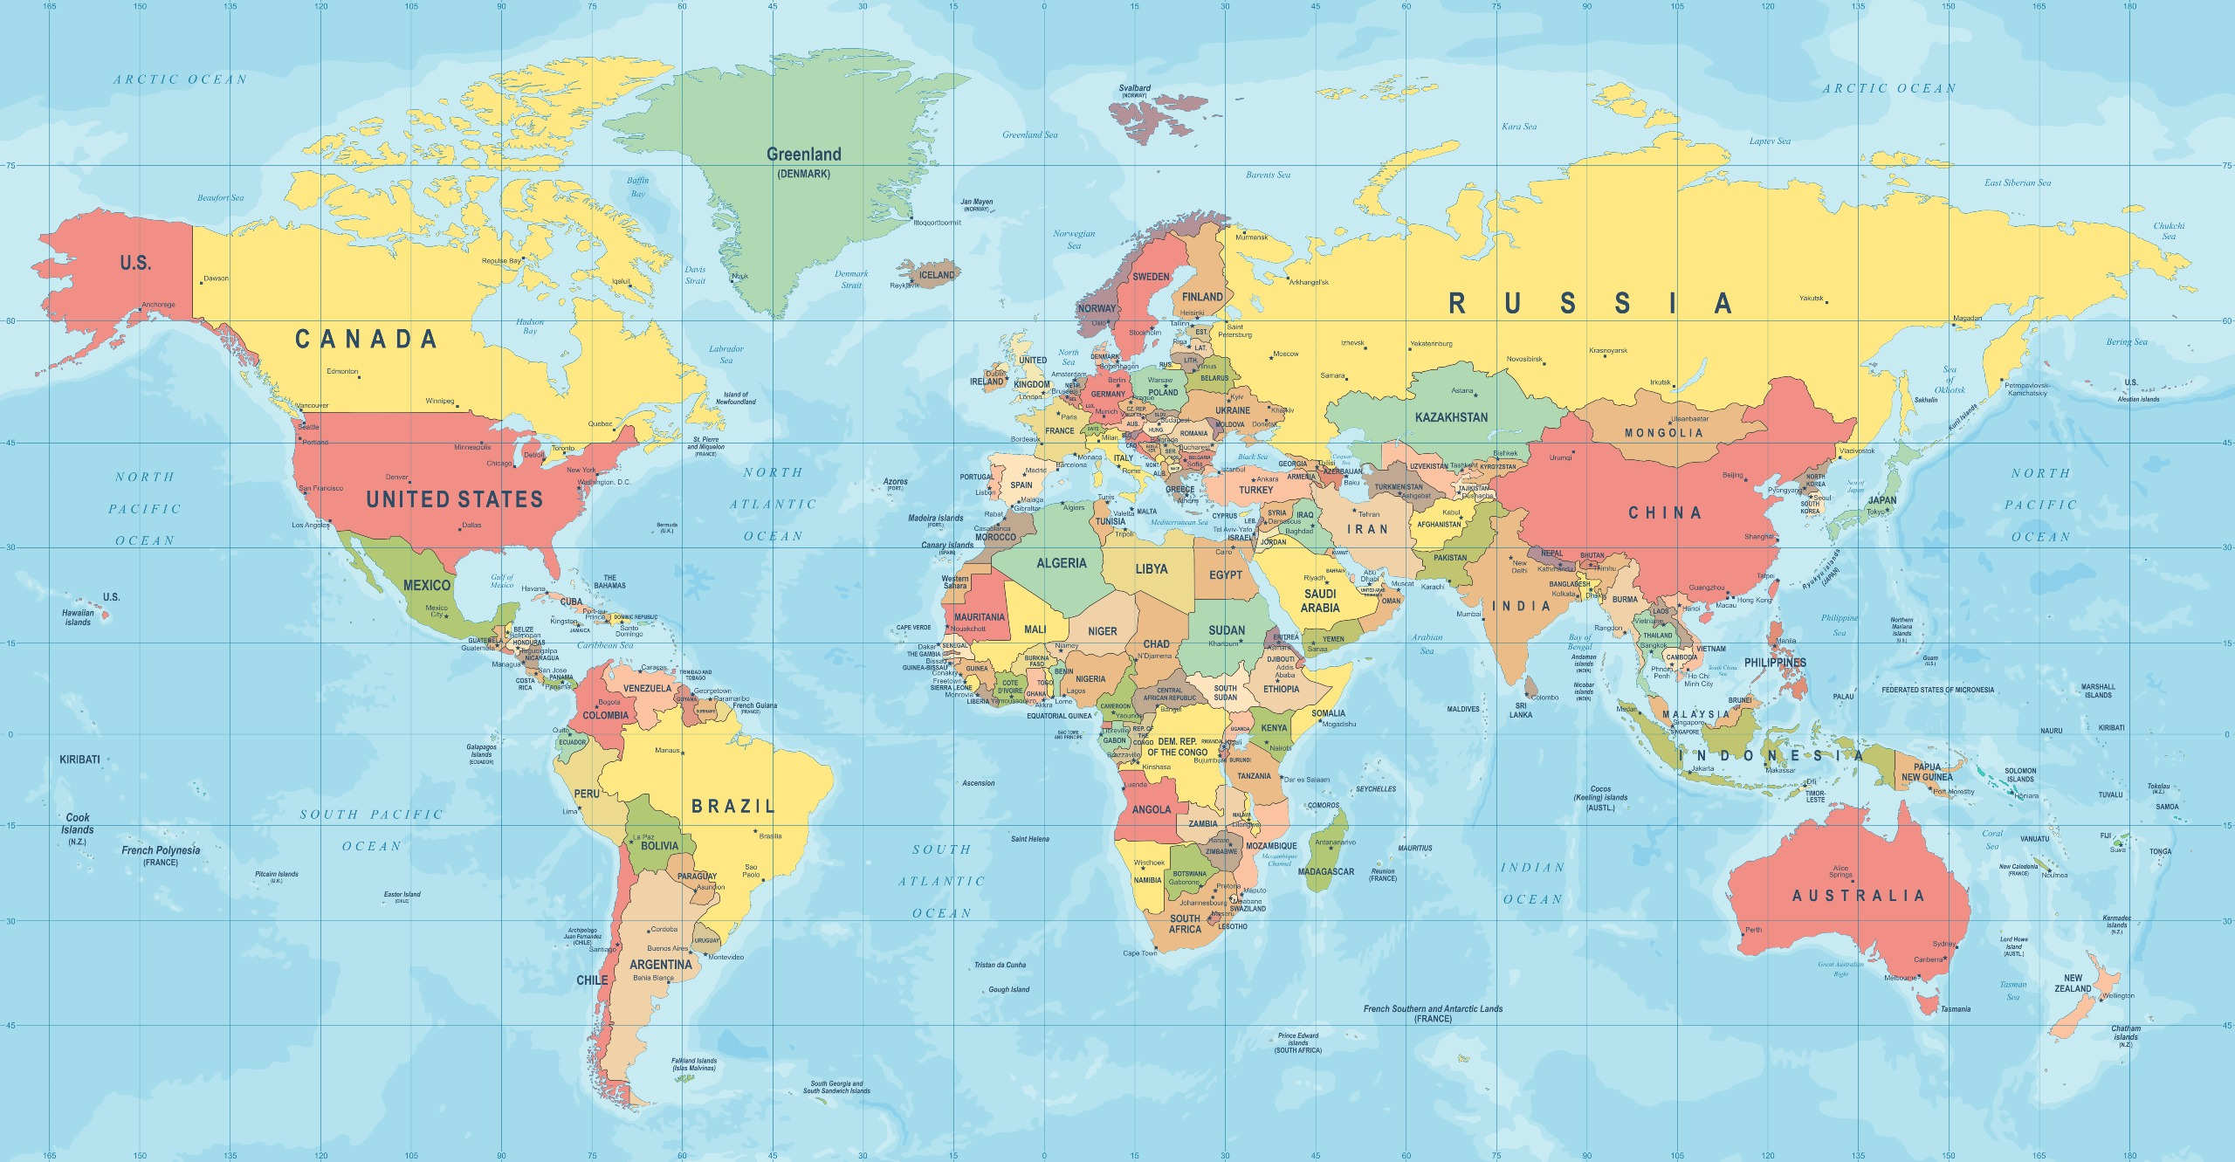
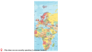
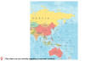
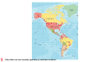

Slide 31
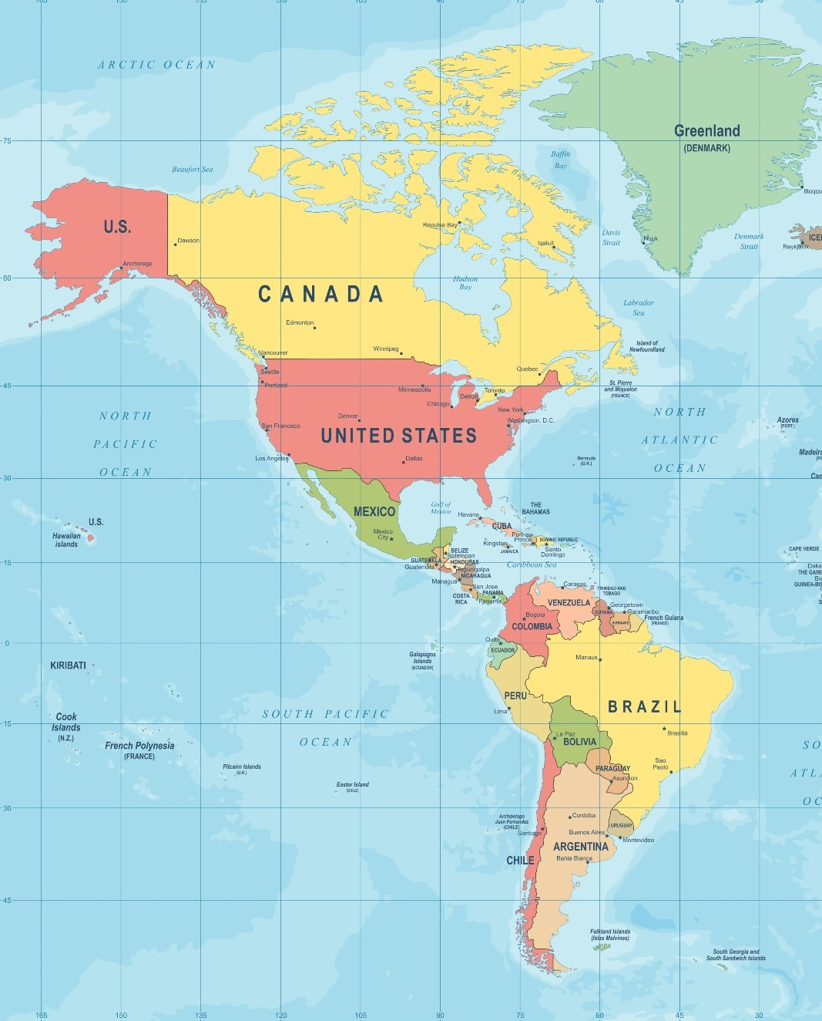

: City where we are currently operating ( customers location)

Slide 32
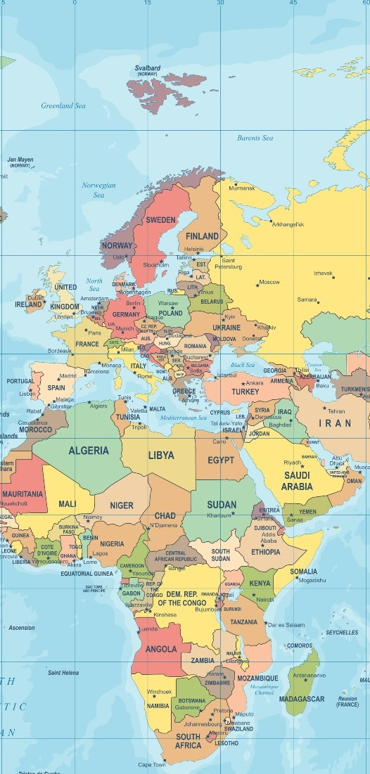
: City where we are currently operating ( customers location)

Slide 33
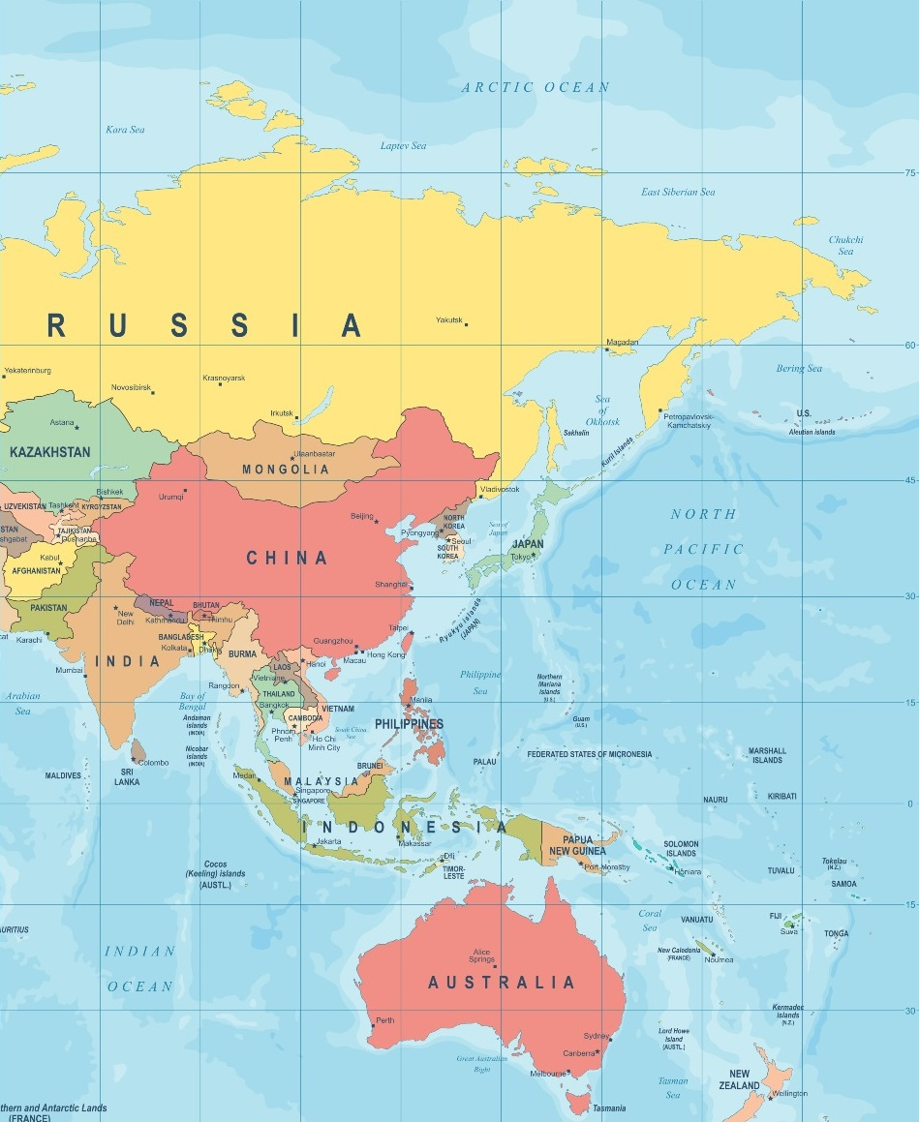
: City where we are currently operating ( customers location)

Slide 34


Tokyo, Japan
: City where we would like to start operating

Slide 35

OUTPUT!
Anchorage,Alaska
Distance:5563 km
Tokyo, Japan
: City where we would like to start operating
: City where we are currently operating

Slide 36

Bergamo, Italy
Piacenza, Italy
Reggio Emilia, Italy
Bergamo – Piacenza = 72.78 km
Reggio Emillia – Piacenza = 82.83 km
: City where we would like to start operating
: City where we are currently operating

Slide 37

OUTPUT!
Bergamo, Italy
: City where we are currently operating

Slide 38

Final Thoughts!
1
Data inconsistencies are solved.

Slide 39
Final Thoughts!
Final Thoughts!
1
Data inconsistencies are solved.
2
Database design is modified and improved.

Slide 40
Final Thoughts!
Final Thoughts!
1
Data inconsistencies are solved.
2
Database design is modified and improved.
3
Profitable insights and analyses are done.

Slide 41



Final Thoughts!
Final Thoughts!
1
Data inconsistencies are solved.
2
Database design is modified and improved.
3
Profitable insights and analyses are done.
Data Engineering
Data Analysis
Profit

Slide 42
THANKS FOR YOUR TIME!

